Slide 1
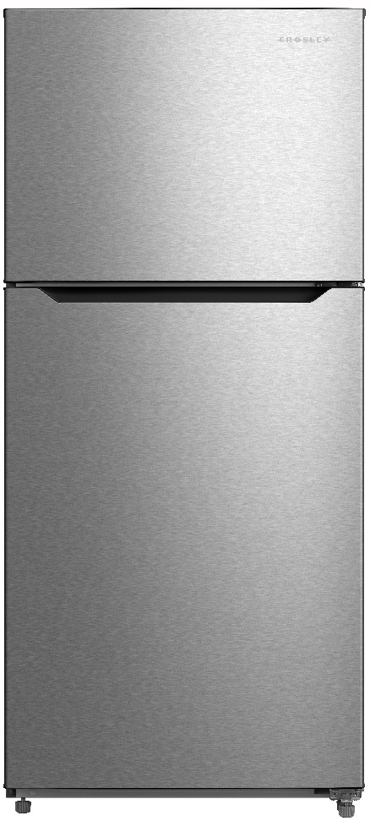
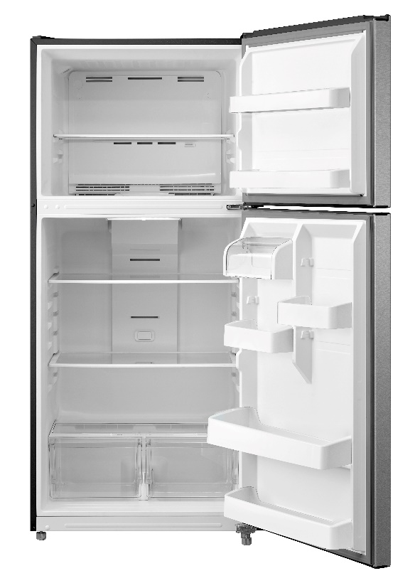
by Crosley Home Products
CRMH203AW/B/S
20.2 CU FT Top Mount Refrigerator
KEY FEATURES
Recessed Handle
3 Glass Shelves -2 Adjustable
2 Full-width Door Bins
2 Half-width Door Bins
2 Full-width Freezer Door bins
Reversible Door
Ice Maker Ready
DIMENSIONS
Height: 66.61”
Width: 29.72”
Depth: 32.6”
AVAILABLE FINISHES
CROSLEY.COM
Emerald Isle, NC
marketing@crosley.com

